Slide 1
User Account Information
Lecture 06

Slide 2
The Goal: an on-line messenger
Suppose you want to write such a program:
List all your friends on-line
Send a message to one of your friends
What you need to know?
John tty9
Marry tty8
fire tty9
Whom to send message (1-3)?

Slide 3
The Goal
a simple messenger to send a string to other’s terminal
Marry> Hellen: How you doing
Helen> msg Marry “How you doing”
Helen
Marry

Slide 4
What you need to know to write a messenger
get user account information (Sec. 6.1-6.6)
get login information of on-line users (Sec. 6.8-6.9)
let your process run as root (Sec. 4.4)
setuid

Slide 5
How to get account information of a user
/etc/passwd

Slide 6
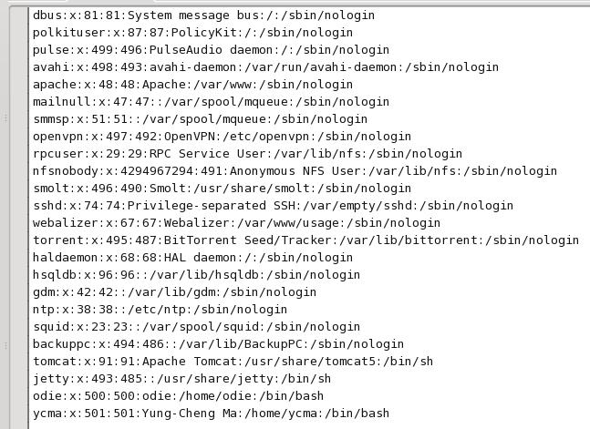
Content of /etc/passwd
all basic information about a user account

Slide 7
Content of /etc/passwd
all basic information about a user account
user name

Slide 8
Content of /etc/passwd
all basic information about a user account
user ID

Slide 9
Content of /etc/passwd
all basic information about a user account
group ID

Slide 10
Content of /etc/passwd
all basic information about a user account
your complete name

Slide 11
Content of /etc/passwd
all basic information about a user account
home directory

Slide 12
Content of /etc/passwd
all basic information about a user account
default login shell

Slide 13
How to get a user’s passwd info
standard library functions: (not system call)
struct passwd *getpwuid (uid_t uid);
struct passwd *getpwnam (char *name);

Slide 14
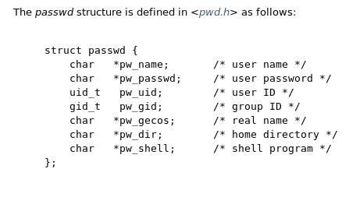
How to get a user’s passwd info
struct passwd defined in <pwd.h>

Slide 15
How to read through /etc/passwd
struct passwd *getpwent (void);
struct passwd *setpwent (void);

Slide 16
Demo: dir_name
list all directory entries, and
display owner names for each file

Slide 17
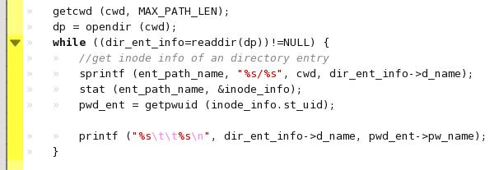
Demo: dir_name

Slide 18
Demo: dir_name
get the user data (from user ID) in /etc/passwd

Slide 19
Similar functions operate on /etc/shadow
struct spwd *getspnam (char *name);
struct spwd *getspent (void);
void setspent (void);
void endspent (void);
Q: What is /etc/shadow?
the system’s real encrypted password file

Slide 20
How to get on-line user information
all through /var/run/utmp

Slide 21
What you need to know to write a messenger
get user account information (Sec. 6.1-6.6)
get login information of on-line users (Sec. 6.8-6.9)
let your process run as root (Sec. 4.4)
setuid

Slide 22
How to get on-line user information
all on-line users info are in /var/run/utmp
ut_user
ut_line
ut_host
ycma
/dev/tty0
odiepc
…
john
/dev/tty1
bbs
…
marry
/dev/pts/1
localhost
…
…
struct utmp defined in “utmp.h”

Slide 23
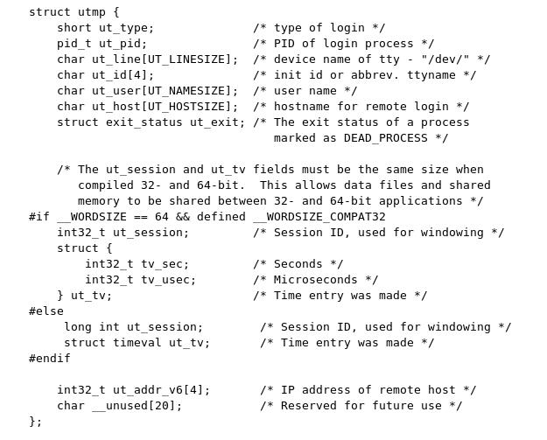
struct utmp

Slide 24
Demo: user_list
to list all on-line users

Slide 25
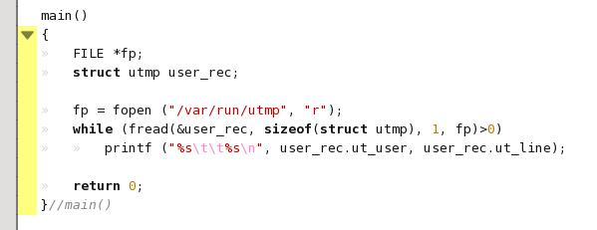
Demo: user_list
just open a file and read its content as dedicated data structure

Slide 26
Other system information
get group info and /etc/group
Section 6.4-6.5
get time and date
Section 6.10
get system configuration
Section 6.9
uname
gethostname() and /etc/hosts

Slide 27
How to know a user’s terminal device?

Slide 28
Recall the Goal
a simple messenger to send a string to other’s terminal
Marry> Hellen: How you doing
Helen> msg Marry “How you doing”
Helen
Marry

Slide 29
What you need to know to write a messenger
get user account information (Sec. 6.1-6.6)
get login information of on-line users (Sec. 6.8-6.9)
let your process run as root (Sec. 4.4)
setuid

Slide 30
How to know a user’s terminal?
read directory entries
/dev/tty*
/dev/pts/*
examine stat to know the owner of a terminal device

Slide 31
Reading a directory
testdir
#include <dirent.h>
main ()
{
DIR *dp;
struct dirent *buf;
dp = opendir (“testdir”);
while ((buf=readdir(dp))!=NULL) {
…//examine each file …
}
}
inode#
file name
1234
test.txt
2358
temp
3019
hello.c
…
…

Slide 32
Reading a directory
open the directory and
allocate internal management data structure
testdir
#include <dirent.h>
main ()
{
DIR *dp;
struct dirent *buf;
dp = opendir (“testdir”);
while ((buf=readdir(dp))!=NULL) {
…//examine each file …
}
}
inode#
file name
1234
test.txt
2358
temp
3019
hello.c
…
…

Slide 33
Reading a directory
testdir
#include <dirent.h>
main ()
{
DIR *dp;
struct dirent *buf;
dp = opendir (“testdir”);
while ((buf=readdir(dp))!=NULL) {
…//examine each file …
}
}
inode#
file name
1234
test.txt
2358
temp
3019
hello.c
…
…
sequentially access each entry by
readdir()

Slide 34
Reading a directory
struct dirent {
ino_t d_ino; //inode number
char d_name[NAME_MAX+1];
};
testdir
#include <dirent.h>
main ()
{
DIR *dp;
struct dirent *buf;
dp = opendir (“testdir”);
while ((buf=readdir(dp))!=NULL) {
…//examine each file …
}
}
inode#
file name
1234
test.txt
2358
temp
3019
hello.c
…
…
buf
3019
hello.c

Slide 35
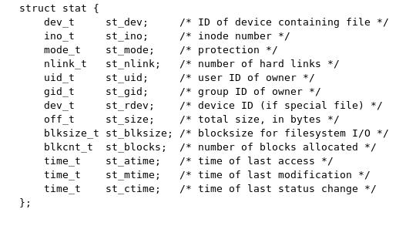
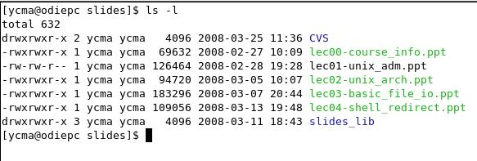
Everything you see from “ls –l” is from struct stat

Slide 36
How to get privilege to write to other’s device file
- setuid

Slide 37
Examine file type and permission
stat.st_mode
Let other users to run as me
…
…
…
set user ID
set group ID

Slide 38
Demo: setuid
make
make install
run read_others from other user’s account

Slide 39
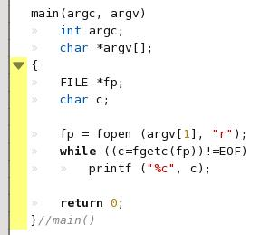
Demo: setuid
the C program has nothing special

Slide 40

Demo: setuid
the magic is in the Makefile!

Slide 41
Demo: setuid
the magic is in the Makefile!
enable the setuid bit to let others run as me

Slide 42
Your Homework

Slide 43
HW 04: an on-line messenger
Suppose you want to write such a program:
List all your friends on-line
Send a message to one of your friends
What you need to know?
John tty9
Marry tty8
fire tty9
Whom to send message (1-3)?

Slide 44
HW 04
a simple messenger to send a string to other’s terminal
Marry> Hellen: How you doing
Helen> msg Marry “How you doing”
Helen
Marry

